Slide 1

GRAPHICAL PASSWORD AUTHENTICATION
I B.Sc DATA SCIENCE

Slide 2
agenda
INTRODUCTION
OVERVIEW OF AUTHENTICATION METHODS
WHAT IS GPA
WHY GPA
TYPES OF GPA
APPLICATIONS
WORKING
CONCLUSION

Slide 3
INTRODUCTION
WHAT ARE AUTHENTICATION METHODS?
Authentication is a method used to verify a user’s identity when the user is trying to access network resources.
Authentication method refers to verifying the identity of someone that maybe a user, a device or an entity who wants to access data resources or applications

Slide 4
Overview of authentication methods
TOKEN BASED AUTHENTICATION
Key cards, Bank cards, Smart cards ……
BIOMETRIC BASED AUTHENTICATION
Fingerprints, Iris scan, Facial recognition …….
KNOWLEDGE BASED AUTHENTICATION
Text based password, Picture based passwords….

Slide 5
What is gpa?(graphical password authentication)
GRAPHICAL PASSWORD AUTHENTICATION OR PICTURE BASED AUTHENTICATION is a a form of authentication using images rather than letters digits or special characters
It was first developed by Sobrado and Birget to deal with the shoulder surfing problem
GPA allows the user to set a pattern password for using the applications

Slide 6
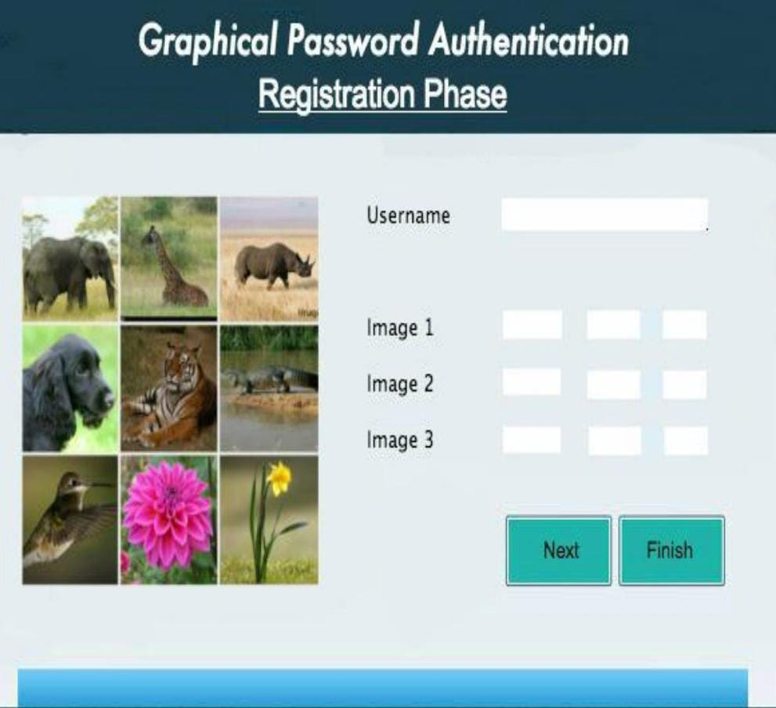
EXAMPLE OF A GPA SERVICE
An example of GPA service is that for
authentication the user is asked to
type his username and after that
he or she is presented with a set
of information which needed to be
Selected in a specific order to login

Slide 7
Why gpa?
Graphical passwords are better alternative than text based passwords in terms of memorability and usability
Psychological studies proves that humans are visual creatures who depend a lot on daily virtual examples than textual ones and so it would be easy for the users to remember them
Also the fact that GPA provides a wider and broader space for passwords and are not limited to alpha numeric permutations. For example take a 1024 x 768 pixel image

Slide 8
Types of gpa
There are two main types of graphical password authentication ,namely
Recognition based password authentication
Recall based password authentication

Slide 9
CONTD OF TYPES OF GPA
RECOGNITION BASED AUTHENTICATION TECHNIQUES
User is presented with a set of random images during registration . The user has to select the particular number of images from this set as a password. During authentication, user has to recognize those preselected image in a correct sequences
RECALL BASED AUTHENTICATION TECHNIQUES
The user is asked to recall something that he or she have selected or created during registration phase and asked to recreate or reselect it in the login phase

Slide 10
Applications of gpa
The GPA can be used in various ways for example in
Various banking systems
Shopping websites
Email systems

Slide 11
Advantages of gpa
Graphical passwords schemes provide a way of making more human-friendly passwords.
The security of the system is very high.
Dictionary attacks can’t effect the system.
Brute force search is also infeasible.
Shoulder surfing is also avoided to a limit.
Easily remembered by users.
Hacking method can also be restrained to an extend.

Slide 12



WORKING
While using Graphical Password Authentication
Each time the software produces randomly shuffeled images of the pattern.
The user must arrange the images in a specific pattern to unlock the device.
This Graphical password authentication ruins out bruteforce attacks.
Disables keyloggers,sniffers,spoofers.

Slide 13
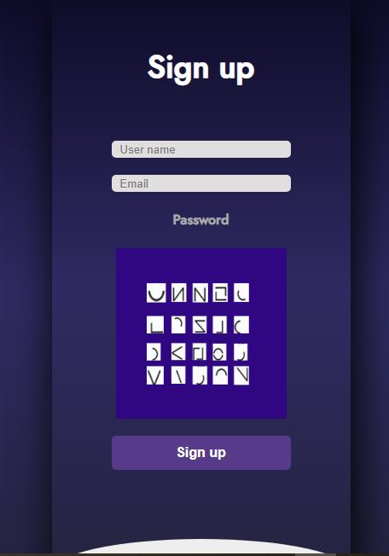
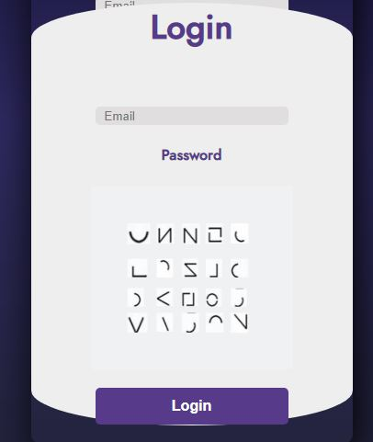

Slide 14
CONCLUSION
Graphical passwords are an alternative to textual alpha numeric passwords.
It satisfies both conflicting requirements i.e , it is easy to remember and it is hard to guess.
By the solution of the shoulder surfing problem it becomes the most secured and easiest password scheme.
As it is not yet widely used , current graphical password techniques cannot be easily hacked.

Slide 15
TEAM MEMBERS [Data science department]
Sudharshan
Sarvaesh Raam
Ajay
Surya Rajiv Kumar
Indra
Sailesh

Slide 16
THANK YOU

